Slide 1
© 2018 Cengage Learning®. May not be scanned, copied or duplicated, or posted to a publicly accessible website, in whole or in part.

Slide 2
Targeting
4
© 2018 Cengage Learning.® May not be scanned, copied or duplicated, or posted to a publicly accessible website, in whole or in part.

Slide 3
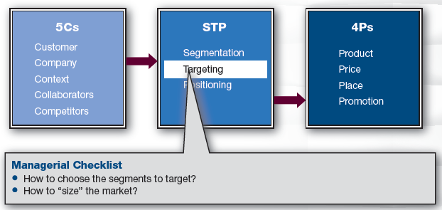
Marketing Framework

Slide 4
Discussion Questions #1
Which segment does Mountain Dew target?
Why do you think it is pursuing this target?

Slide 5
What Is Targeting and Why Do It?
Targeting is selecting one or more market segments to pursue
Why? It is hard to be all things to all people

Slide 6
How to Choose a Target (slide 1 of 2)
Bottom up: profitability
How profitable will this segment be?
Function of the current market size, its anticipated growth, current and anticipated levels of competition, customer behavior and expectations
Top down: strategic fit
Does this market fit with who we are?
Understand firm’s resources, strengths, weaknesses, brand personalities, etc.

Slide 7
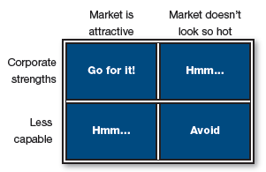
Strategic Criteria for Targeting
“Go for it” and “avoid” are easy decisions

Slide 8
How to Choose a Target (slide 2 of 2)
“Hmms” are dilemma scenarios
The video game market is attractive but you have no strength in this market
Can you develop a strength in video games? How much will this cost? etc.
Your strength is in thumb drives but the market is unattractive
Is there any segment that sees value in thumb drives? Can we redesign the product to give it value? How much will this cost?

Slide 9
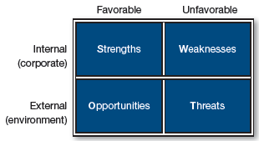
SWOT (slide 1 of 3)

Slide 10
SWOT (slide 2 of 3)
Strengths and weaknesses are relative to competitors
Should include customers’ perspectives
Requires market research
Strategies:
Leverage firm’s strengths
Improve or design around firm’s weaknesses

Slide 11
Discussion Questions #2
Assume you want to start your own business. What are your strengths and weaknesses?
How might you leverage your strengths and address your weaknesses?

Slide 12
SWOT (slide 3 of 3)
Opportunities and threats are usually driven by changes in one of the 5Cs
For example:
The rise in Internet access
Growing Hispanic population in United States
New competitors
New offerings from existing competitors
Lack of competitors within a market
Aging baby boomers

Slide 13
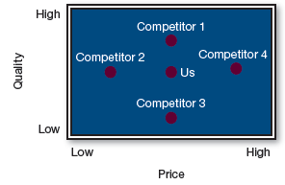
Competitive Analysis
Companies typically assess their strengths relative to their competitors

Slide 14
Competitive Comparisons
Perceptual maps show customers’ perceptions of firm’s strengths/ weaknesses relative to competitors
In many product categories, price and quality are key
Quality is defined by the industry

Slide 15
Competitive Comparisons Questions #1
Which competitors do we dominate on price? Quality?
If we pursue a price-sensitive target, which competitor would be most challenging?

Slide 16
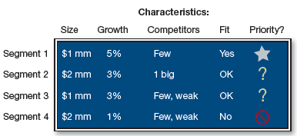
Competitive Comparisons Questions #2
Which segment would you pursue? Why?
Why are the largest segments less attractive to the firm?

Slide 17
Sizing Markets Considerations
Some estimates are less firm than others
Give intervals and “what if” scenarios
Each estimate should be as precise as possible
The more precisely defined the segment, the easier the numbers are to estimate

Slide 18
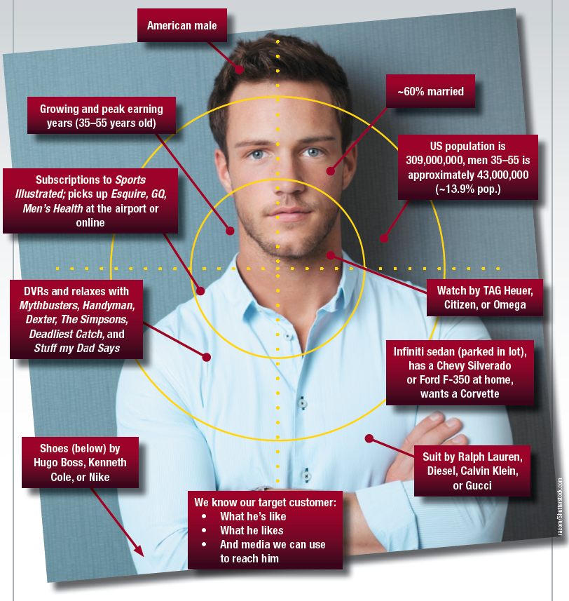
Anatomy of a Market Segment

Slide 19
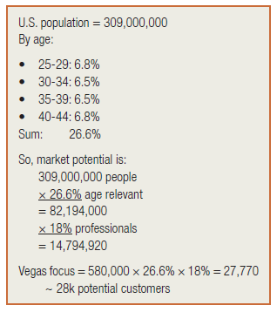
Concept in Action: Market Sizing (slide 1 of 2)
How much advice can I sell?
Use Factfinder.census.gov to estimate

Slide 20
Concept in Action: Market Sizing (slide 2 of 2)
28,000 is the market potential
Segments that refine total U.S. population
Age 25–44
Assume 26.6% of total population
Professional careers
Assume 18% professionals
Local population
Assume 580,000 in Las Vegas

Slide 21
Concept in Action: Discussion Questions
Is the market attractive?
Which numbers do you have the least confidence in?

Slide 22
Concept in Action: Sensitivity Analyses
Conduct sensitivity analyses on the harder to verify numbers
Increase and decrease the numbers and determine the impact on market size
This process will determine
Which numbers have the biggest impact
Conduct more research to ensure accuracy
The upper and lower bounds of the market, which will help planning

Slide 23
Concept in Action: Additional Factors (slide 1 of 2)
Additional factors—estimate growth
Use census to determine size of additional cohorts
Obtain sales data for previous years and extrapolate using a moving average
e.g., 3-year moving average would average years 1, 2, 3; then average years 2, 3, 4; then average years 3, 4, 5; then fit a curve to the data (regression)

Slide 24
Concept in Action: Additional Factors (slide 2 of 2)
Additional factors—profitability
Profitability per customer likely depends on their segment
Quality of employees affects costs
Additional factors—competition
How fierce is the competition? Is there one firm or 30 firms? Does the one firm dominate the market?
Search Yellowpages.com for competitors

Slide 25
Concept in Action: B2B Market Sizing
Census.gov cross-classifies businesses by sector (e.g., NAICS codes) and size (e.g., by sales or number of employees)
Markets for some products or services might be limited only by imagination

Slide 26
Market Sizing
Use the purchase decision-making process: Awareness, trial, repeat, etc.
Population × %aware× %trial× %repeat
Multiply by how much & how often buy
(Population× %aware× %trial× %repeat)× Per annum purchase
Multiply by average retail price paid to translate numbers into money

Slide 27
Managerial Recap
Targeting is important but not difficult
Choose target by iterating between
Corporate fit
Utilize SWOT to help clarify corporate fit
Segment sizing
Use secondary data (e.g., demographics)
Use customer survey data on attitudes and preferences and use behavioral data to smooth out the size estimation

